Slide 1
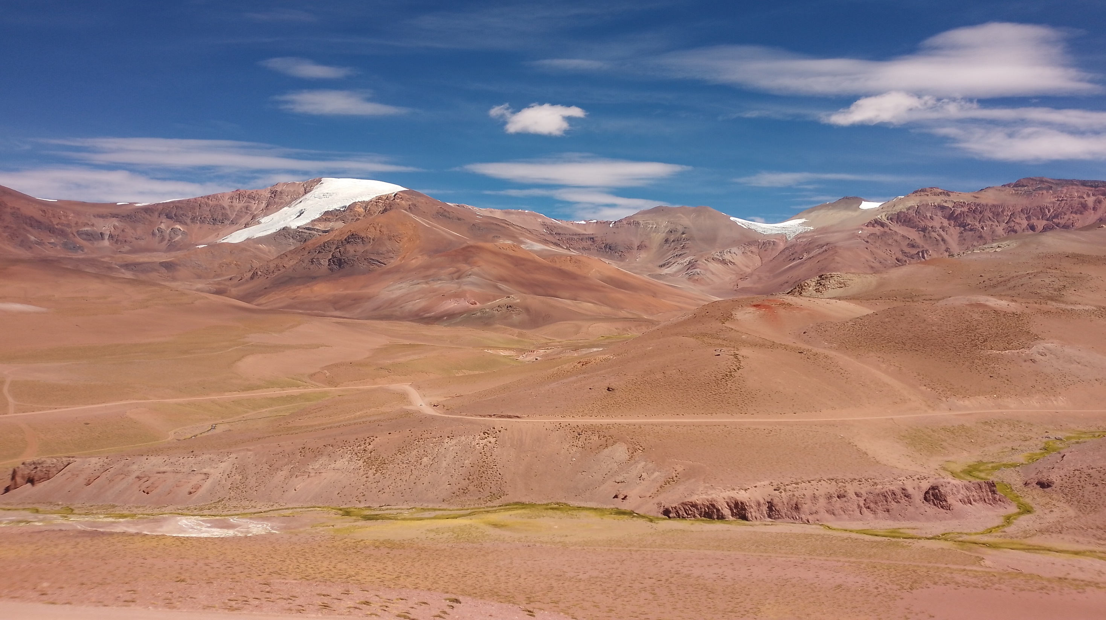

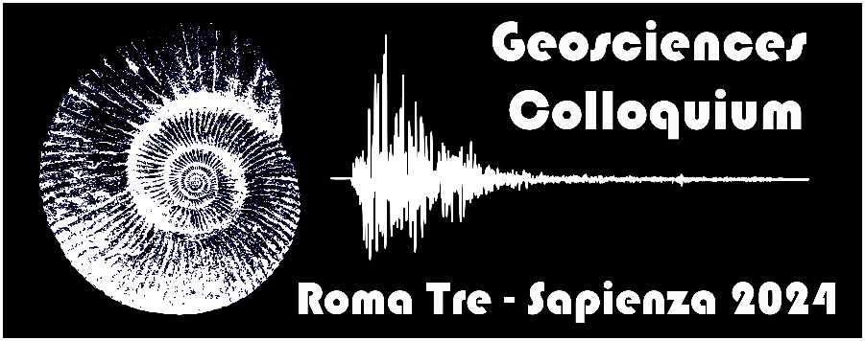



26.03.2024 - h:14:00 - Webinar on Teams
Catastrophic slab loss in southwestern Pangea preserved in the mantle and igneous record
Guido Gianni
Consejo Nacional de Investigaciones Científicas y Técnicas (CONICET)
Universidad Nacional de San Juan, Argentina
https://teams.microsoft.com/l/meetup-join/19%3aRyqVtS3ES2vwEMmPSyvLYD4pGoB8FNyWqdbViQMXG8Y1%40thread.tacv2/1710971375788?context=%7b%22Tid%22%3a%22ffb4df68-f464-458c-a546-00fb3af66f6a%22%2c%22Oid%22%3a%2282ff11cc-5157-41af-92ed-e10be63bf6a7%22%7d
For information: paolo.ballato@uniroma3.it or fabio.trippetta@uniroma1.it

Slide 2
ABSTRACT
The Choiyoi Magmatic Province represents a major episode of silicic magmatism in southwestern Pangea in the mid-Permian-Triassic, the origin of which is intensely debated since the 80’s.
Here, we integrate plate-kinematic reconstructions and the lower mantle slab record beneath southwestern Pangea that provide clues on late Paleozoic-Mesozoic subducting slab configurations. Also, we compile geochronological information and analyze geochemical data using tectono-magmatic discrimination diagrams.
We demonstrate that this magmatic event resulted from a large-scale slab loss. This is supported by a paleogeographic coincidence between a reconstructed 2,800-3,000-km-wide slab gap and the Choiyoi Magmatic Province and geochemical data indicating a slab break-off fingerprint in the latter. The slab break-off event is compatible with Permian paleogeographic modifications in southwestern Pangea.
These findings render the Choiyoi Magmatic Province the oldest example of a geophysically constrained slab loss event and open new avenues to assess the geodynamic setting of silicic large igneous provinces back to the late Paleozoic.

